Slide 1


Course title: Computer Networking Lab Course Code: CSE 312 Project Title: Wireless networking in cisco Packet tracer [simulator] Submitted To: Shimul Dey Katha (Lecturer, CSE) Green University Of Bangladesh Group no: 09 Submitted by: MD Shahrior Shawon Prio ID: 192002032 Mamun UR Rashid ID: 201015066 Dept. of Computer Science and Engineering Green University Of Bangladesh.
Project Presentation

Slide 2
Introduction
The brief of the project is wireless networking, which is a method homes, telecommunications networks uses to connect various equipment.
To avoid the costly process of introducing cables into a building or different locations.
So, we made a project using tools, and the practices that we learned from the lab of this course.

Slide 3
Motivation
Information Technology has revolutionized the life of human beings and has made lives easier by the various kinds of applications.
Providing broadband access to citizens, communities, public institution.
Developing businesses has become a strategic objective for governments and international organizations worldwide.
In particular, serious problems related to the “digital divide” have been widely recognized by public administrations.
However, the solution to these problems is not straightforward.

Slide 4
Objective
In this project our first objective is to build a standard wireless communication on our practices from the lab.
As well as we want to increase the options of wireless networking .
The specific objective is to create a system which is easy to communicate via wireless networking.

Slide 5
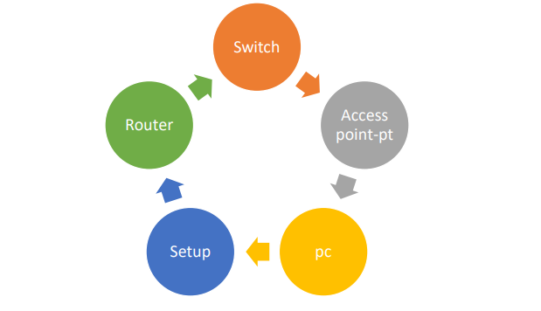
Methodology

Slide 6
Tools and Technique
Tools:
Cisco Packet Tracer
Laptop and Desktop
Router
Switch
Server DNS
SERVER HTTP
Access Point-PT
Wires

Slide 7
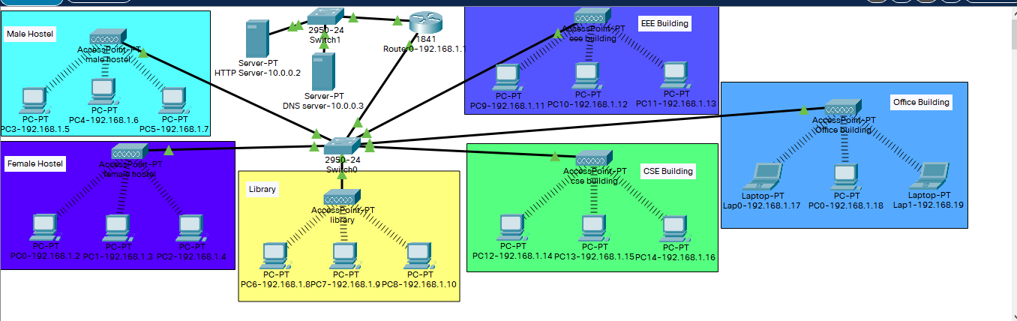
Setting Up The Environment

Slide 8
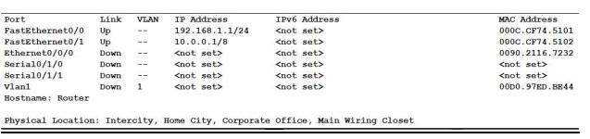
Router

Slide 9
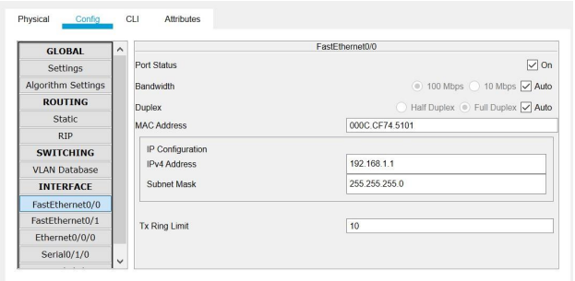
Router IP configure: FastEthernet 0/0

Slide 10
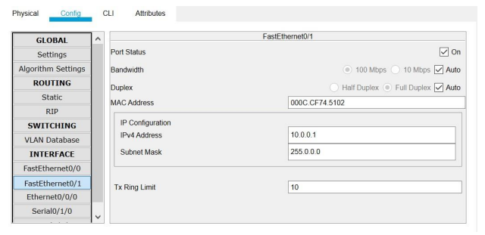
Router IP configure: FastEthernet 0/1

Slide 11
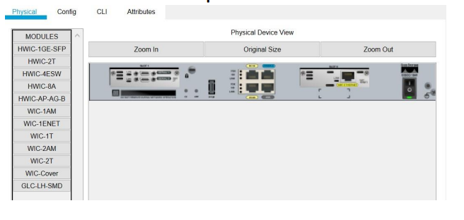
Router connect with WIC 2T port:

Slide 12
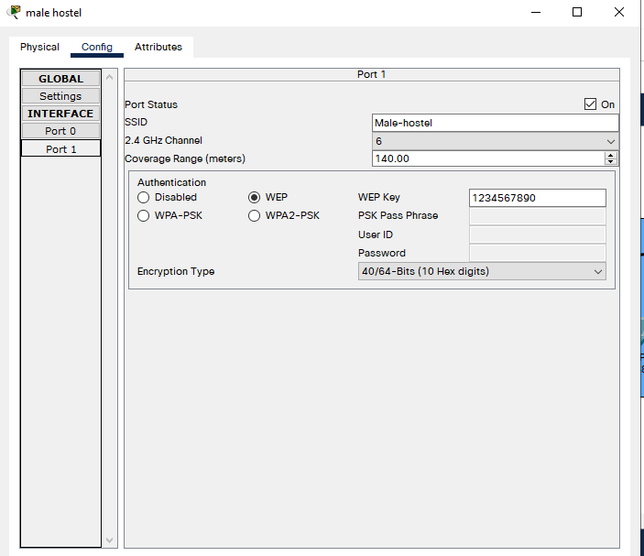
Access Point: Male_Hostel (As well as other buildings)

Slide 13
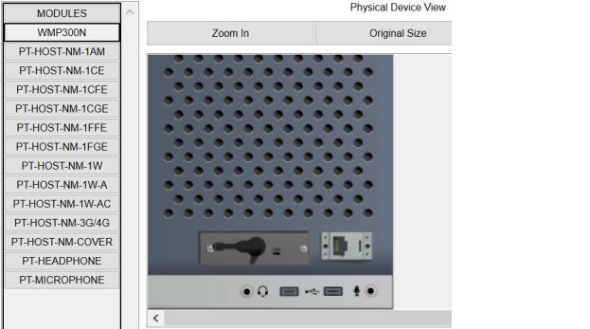
All PC Setup WMP300N port for wireless network connection

Slide 14
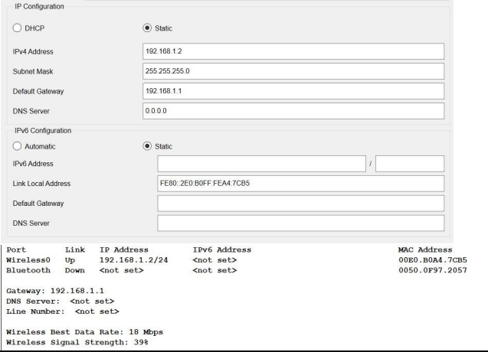
PC0 IP config (same way for all the PC)

Slide 15
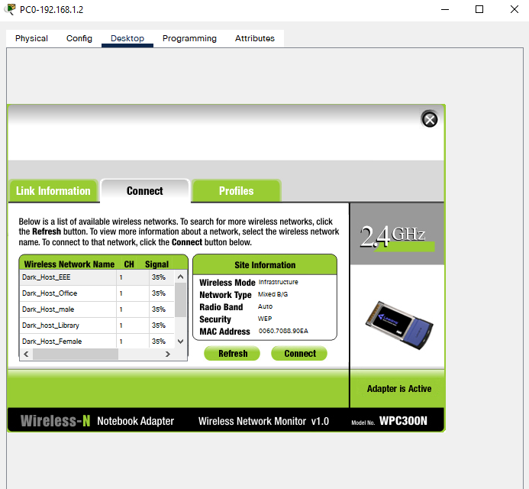
All wireless network list

Slide 16
Conclusion
While implementing the project we faced some issue on Cisco Packet Tracer cause sometimes it doesn’t work properly on low end PC and versions are another problem.
But we were able to successfully complete the project and it simulates smoothly.

Slide 17
References
Mostly Lecture Slides
https://stackoverflow.com/
https://github.com/
https://YouTube.com

